Slide 1
Wired and wireless LAN
From MAC perspective

Slide 2
Data link layer

Slide 3
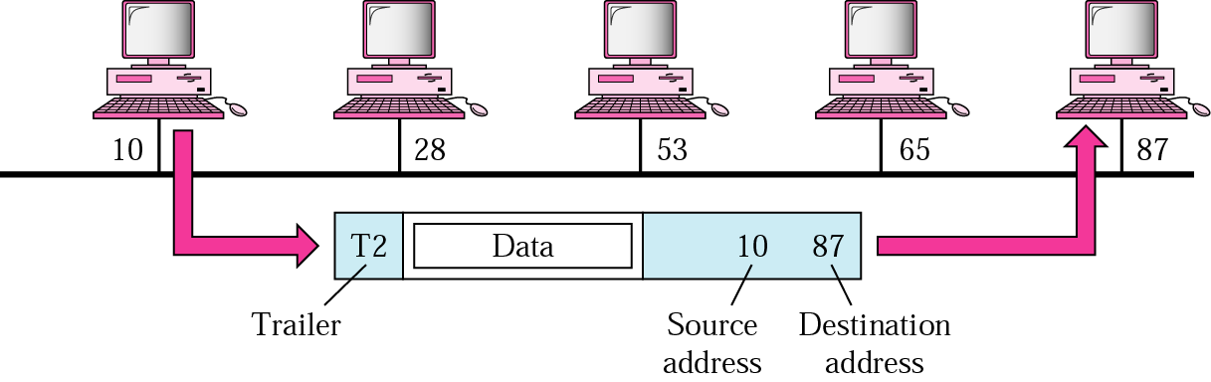
At data link layer…

Slide 4

A
B
C
D
10
51
60
24
66
E
A
P
10
66
95
F
A
P
12
G
56
H
95
56
P
A
52
I
54
52
54
80
34
19
L
P
N
M

Slide 5
Access control

Slide 6
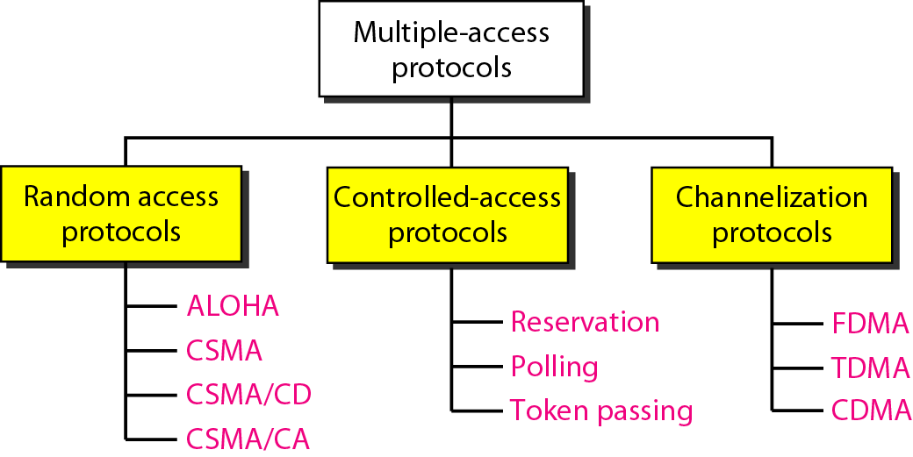

Slide 7
CSMA
Carrier Sense Multiple Access Technique
All stations are required to sense the medium before trying to use it
Sense – checking whether its idle or busy.
Reduces possibility of collision but cannot eliminate it.
Reason for it – “propagation delay”

Slide 8

A
B
C
D
t₁
t₀

Slide 9
Propagation delay
If the first station's signal has not yet reached the second one, the latter will sense an idle channel and will also begin sending, resulting in a collision
The longer propagation delay, worse the performance of the protocol

Slide 10
Protocol Decisions
What to do if the medium is busy
What to do if channel is idle
Persistence methods
1-persistence
Non-persistence
p- persistence

Slide 11

non- persistent
Busy
Channel ?
Wait Random Time
Idle
Transmit

Slide 12
CSMA/CD
Carrier sense multiple access – collision detection
Augmentation of algorithm to handle collision
Monitors medium while sending frame

Slide 13
CSMA/CD
A
B
C
D
t₁
t₂
t₄
t₃
Collision occurs

Slide 14
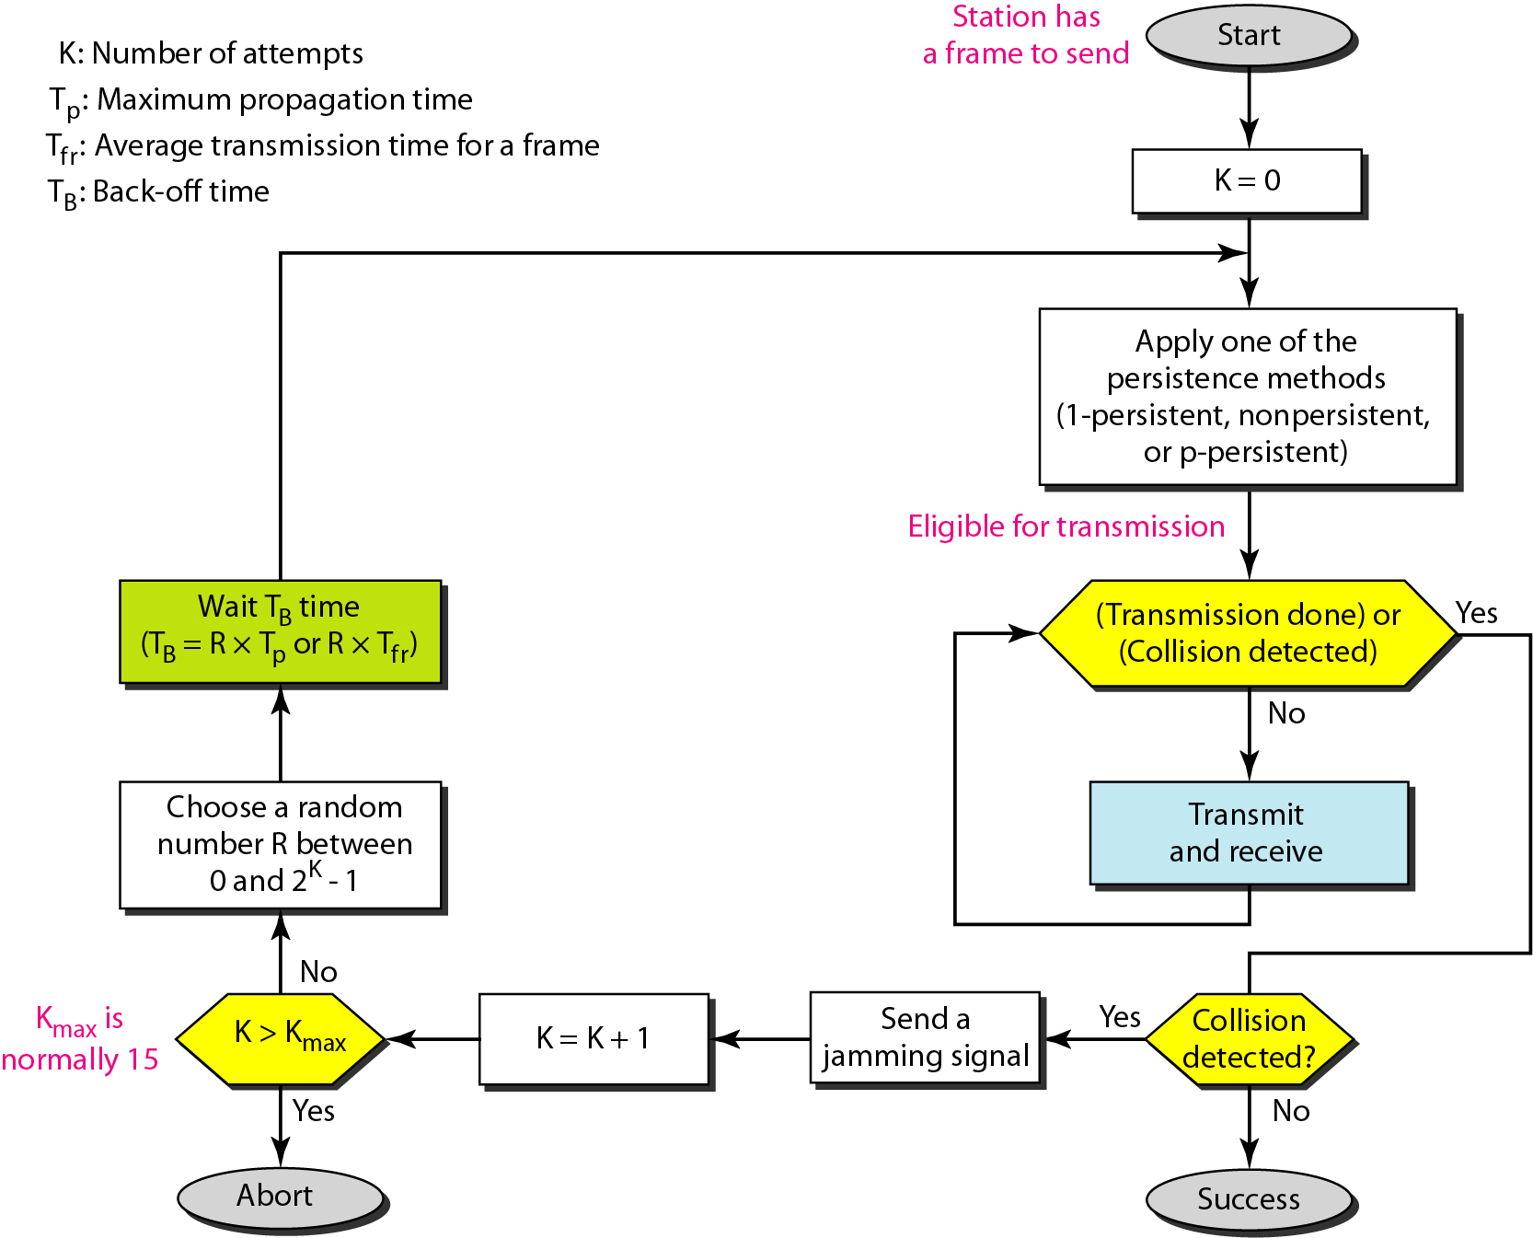

Slide 15
CSMA/CA
Carrier Sense Multiple Access – Collision Avoidance
In wired comm, the collision can be detected b’caz the energy almost doubles on collision
In wireless comm, additional energy after collision may be hardly 5- 10%
Hence a mechanism is used to avoid collision rather than detecting it.

Slide 16
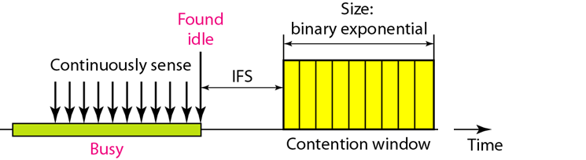
Timing in CSMA/CA

Slide 17
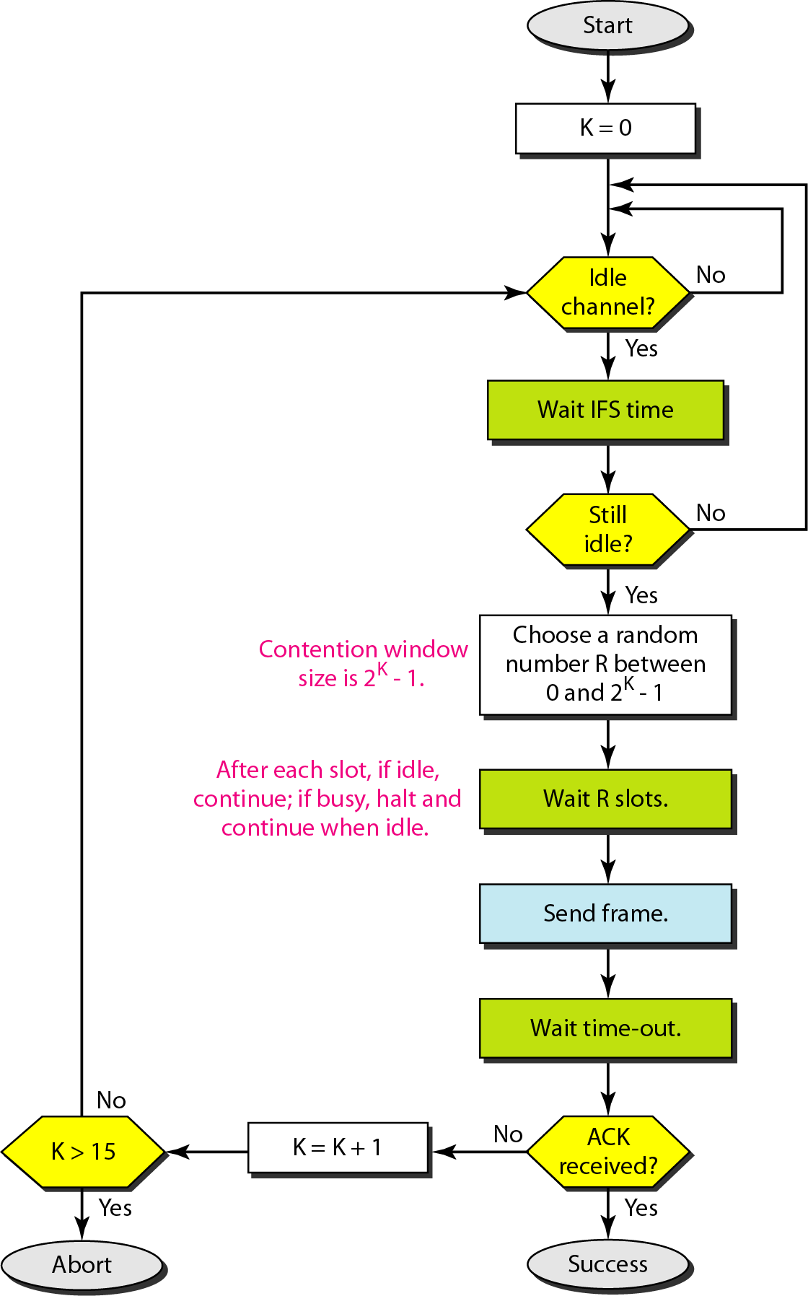

Slide 19
Channelization
FDMA
TDMA
CDMA

Slide 20
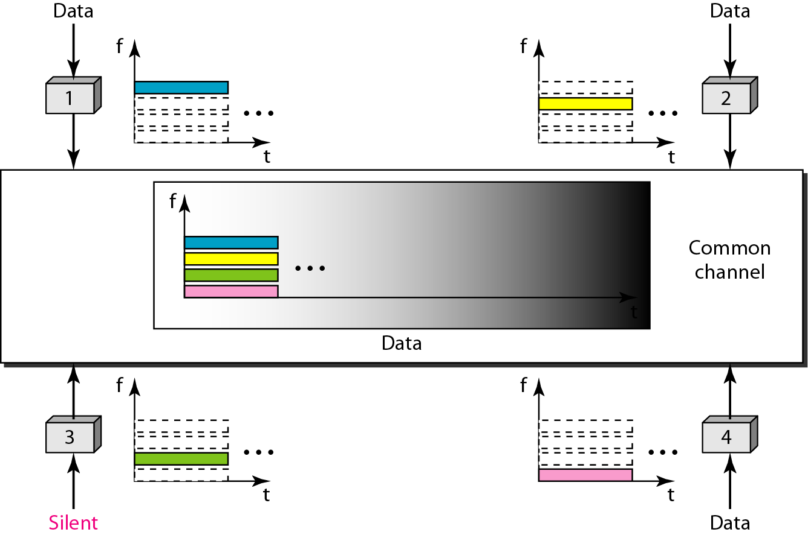
FDMA

Slide 21
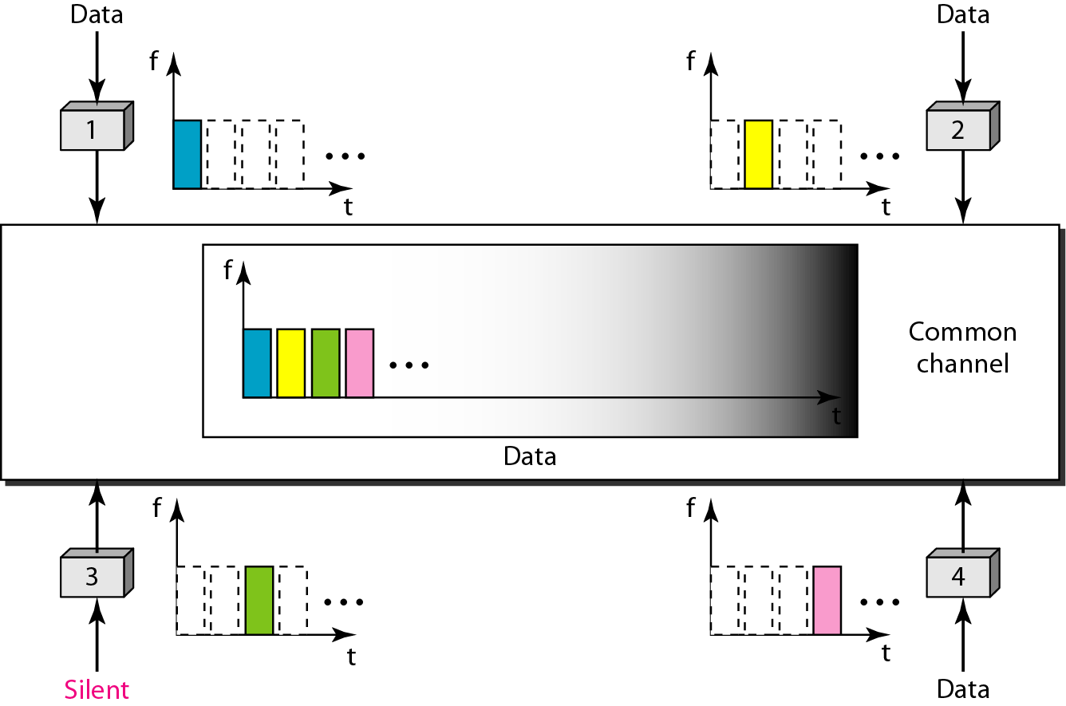
TDMA

Slide 22
IEEE special project 802 (Yr. 1985)
IEEE 802.1 : Bridging & Management
IEEE 802.2 : Logical Link Control
IEEE 802.3 : CSMA/CD (Ethernet) Access Method
802.3u - fast Ethernet
802.3z - Gigabit Ethernet
802.3ae – 10 Gigabit Ethernet
IEEE 802.5 : Token Ring Access Method
IEEE 802.11 : Wireless
IEEE 802.15 : Wireless Personal Area Networks
IEEE 802.16 : Broadband Wireless Metropolitan Area Networks

Slide 23
LAN
LAN consists of a shared medium and a set of hardware and software for interfacing devices to the medium and regulating the orderly access to the medium.

Slide 24
Wired LAN
ETHERNET

Slide 25
Ethernet Evolution
Standard – 10Mbps
Fast – 100Mbps
Gigabit – 1Gbps
Ten-Gigabit – 10Gbps

Slide 26





802.3 Frame Format
Physical layer header
Preamble (7) | SFD (10101011) | DA (6) | SA (6) | Len/type (2) | Data (46-1500) | CRC (4)
Physical addresses
56 bits of alternating 1 and 0

Slide 27
Wireless LAN
802.11

Slide 28

Infrastructure Vs Ad Hoc networks
N1
N2
N1
N2
N3
AP
N3
N4
Ad Hoc Ntks
Infrastructure Ntks

Slide 29
N1
N3
N2
N5
N4
AP
AP
AP
N6
N3
BSS
BSS
BSS
Distribution System
ESS

Slide 30
Physical Layer

Slide 31
Physical Layer Specifications
Upper Layers
802.11 FHSS | 802.11 DSSS | 802.11a OFDM | 802.11b HR-DSSS | 802.11g OFDM

Slide 32
802.11 FHSS Technical Details
Band: ISM -2.4 GHz
Range: 2.4 -2.48 GHz
No. of channels: 79 channels of 1 MHz
Modulation: FSK (2 –level, 4-level)
Data Rate: 1/2 Mbps

Slide 33
MAC-CSMA/CA

Slide 34
Source
Destination
DIFS
RTS
SIFS
Network Allocation Vector
CTS
SIFS
Data
SIFS
ACK
CSMA/CA

Slide 35
Routing

Slide 36
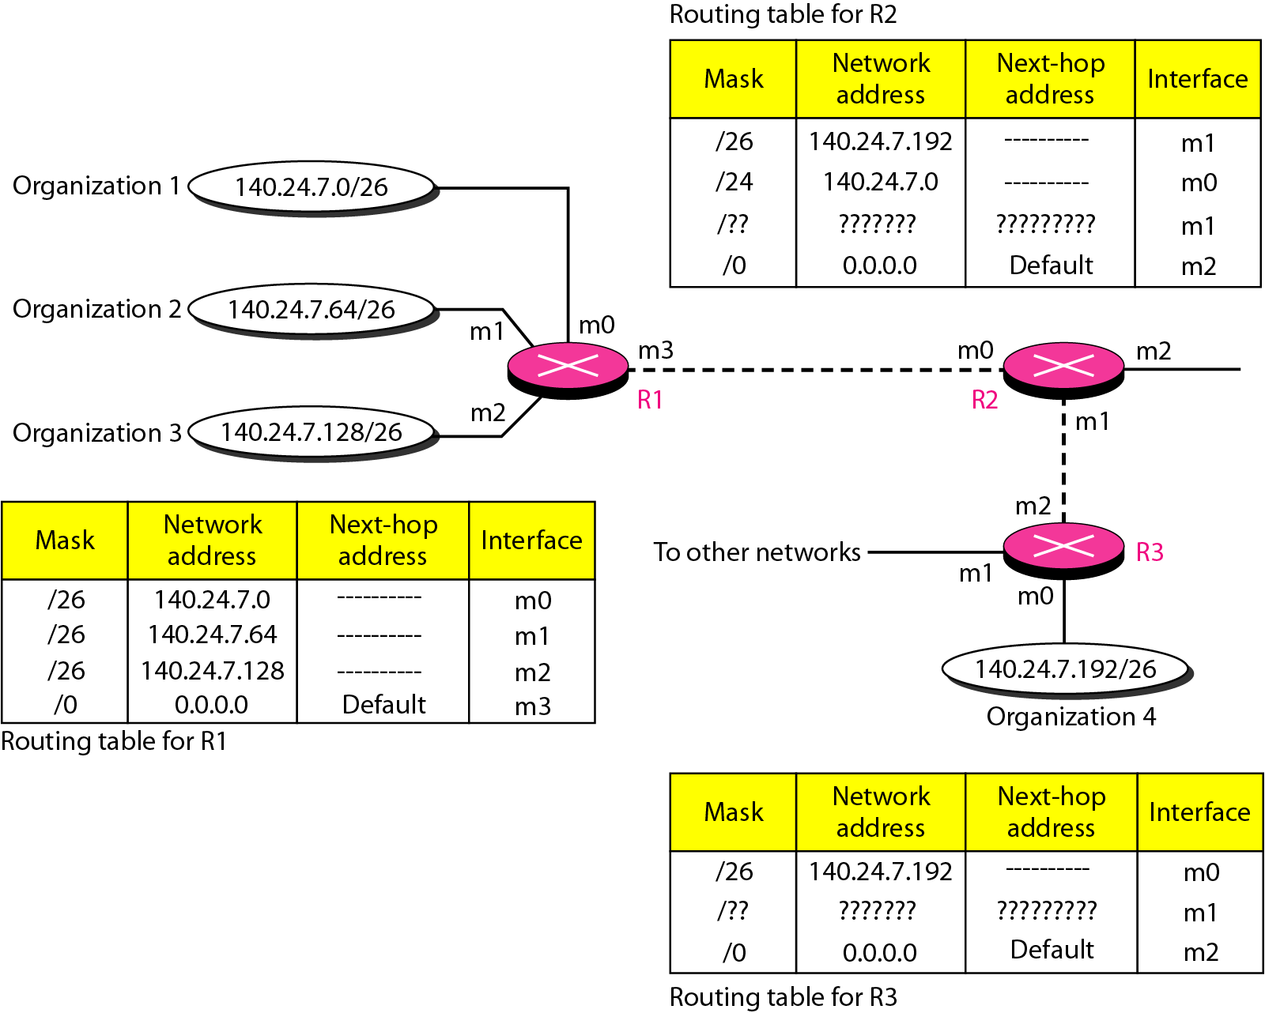
Routers and tables

Slide 37
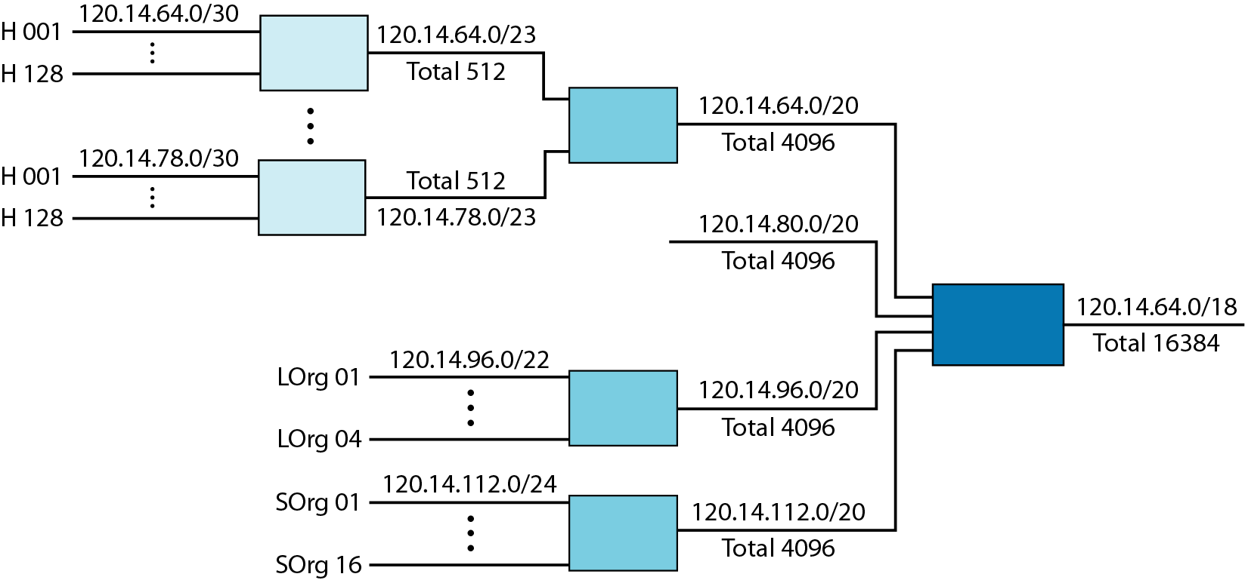
Hierarchical routing

Slide 38
Unicast routing protocols

Slide 39
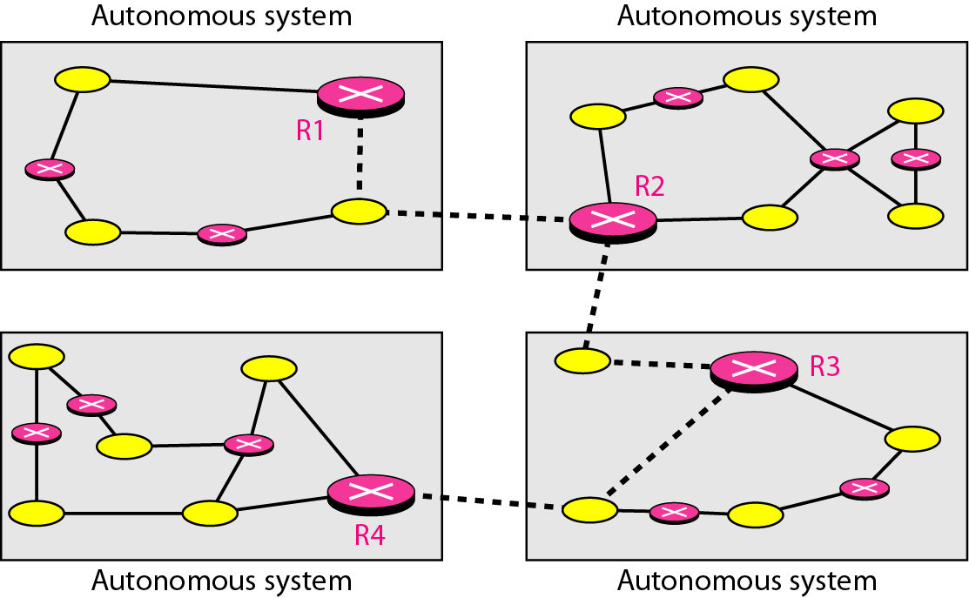
Autonomous system

Slide 40
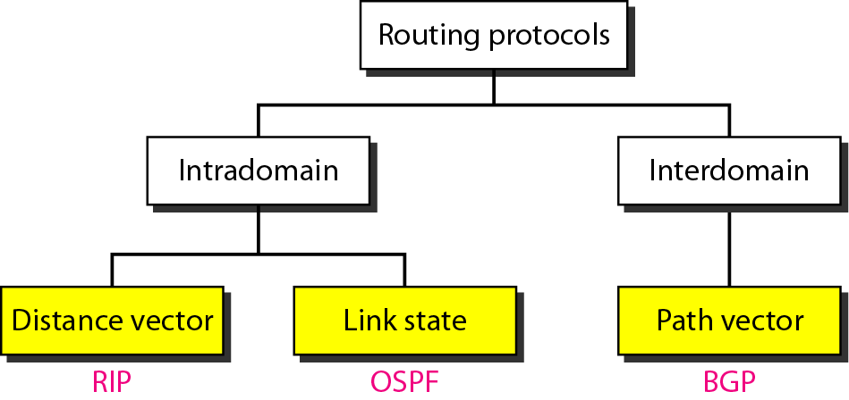
Routing protocols

Slide 41
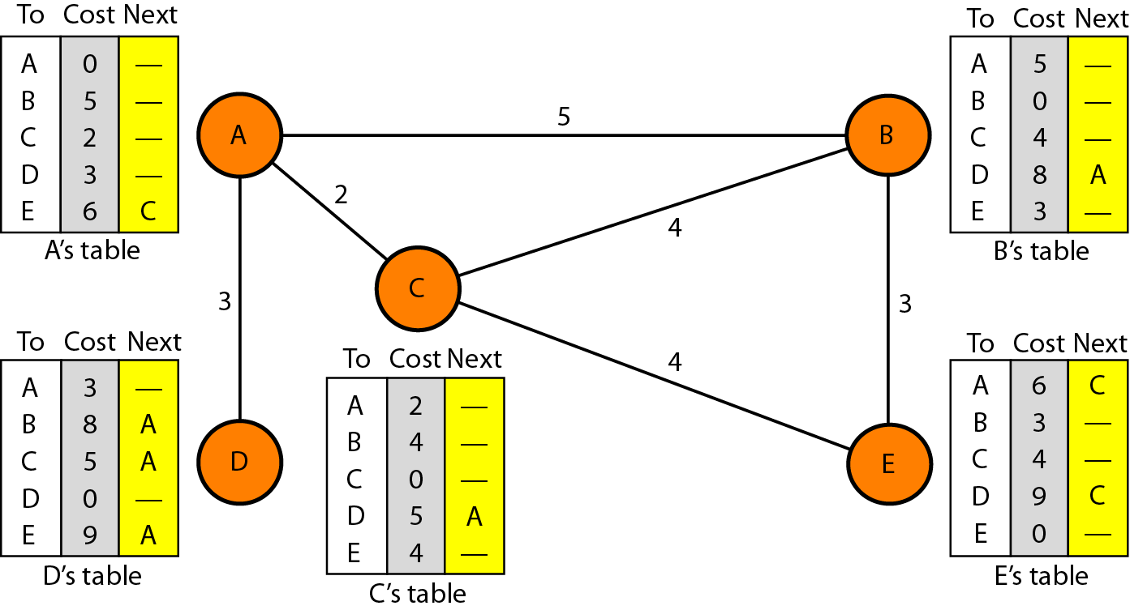
Distance vector routing protocols

Slide 42
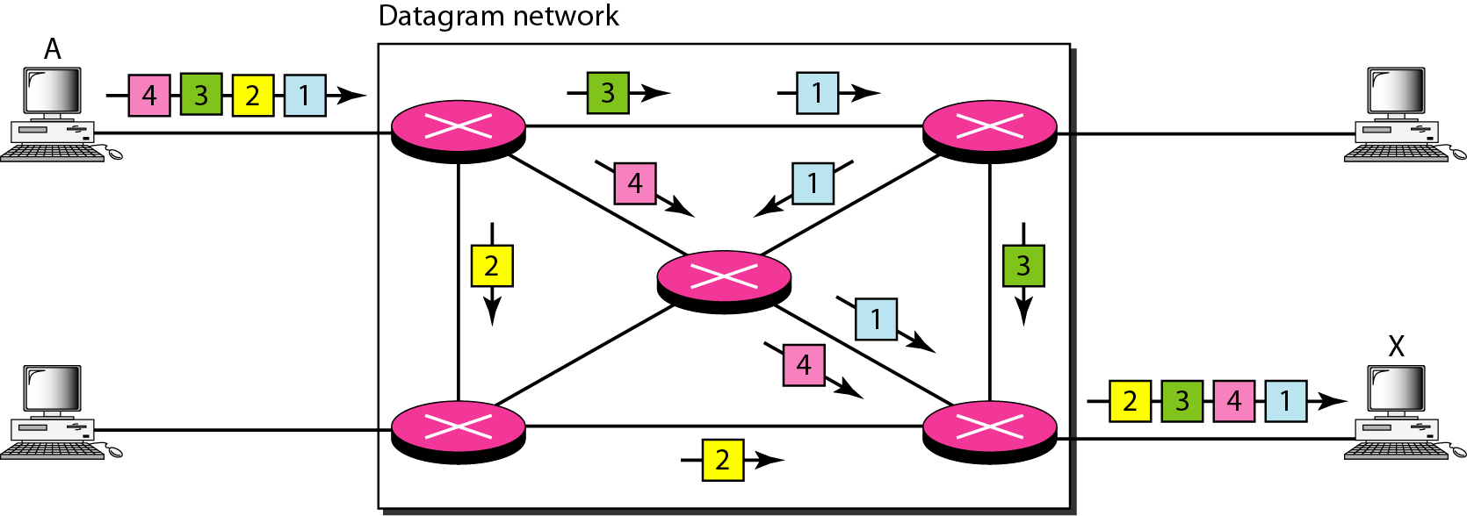
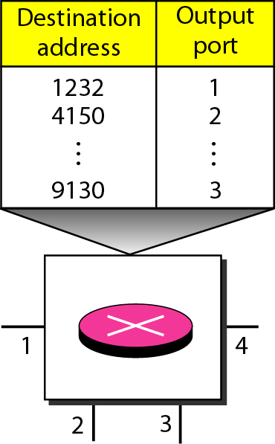

Slide 43
Datagrams
A single message is divided into datagrams.
Individual datagrams are not treated as a single stream of data even if they belong to the same message.
Datagrams from one message can take different paths to the destination.
Datagrams can arrive out of order.

